Slide 1
Overview

Slide 2
Topics
Traditional solutions vs Machine Learning
Model definition
A brief History of Neural Networks
Supervised, Unsupervised and Reinforcement Learning
Deep Learning
Example: does money make people happy?
Challenges: Insufficient Quantity of Data, Nonrepresentative Dataset, Poor-Quality Data, Overfitting and Underfitting
Testing
Bias and Variance
Validation
No free-lunch theorem

Slide 3
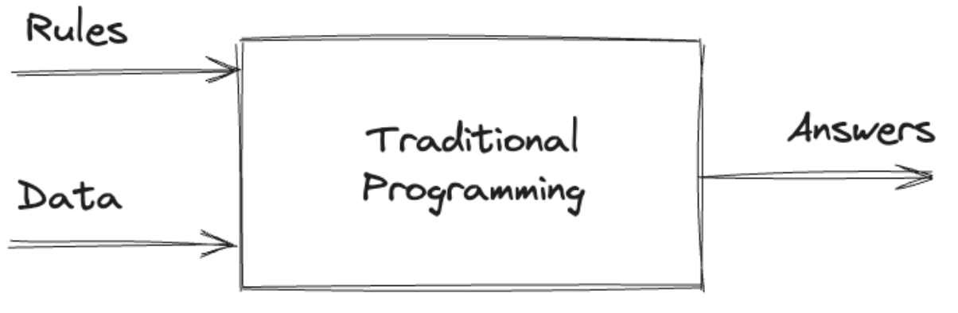
Traditional Programming (1)
Programmers design the algorithm that
takes input,
applies rules,
returns output
Internal operations are planned out by the programmer and implemented explicitly
This approach works fine for many problems
for example: we know that water boils at 100°C, so it’s easy to write a program that can predict whether water is boiling based on its current temperature

Slide 4
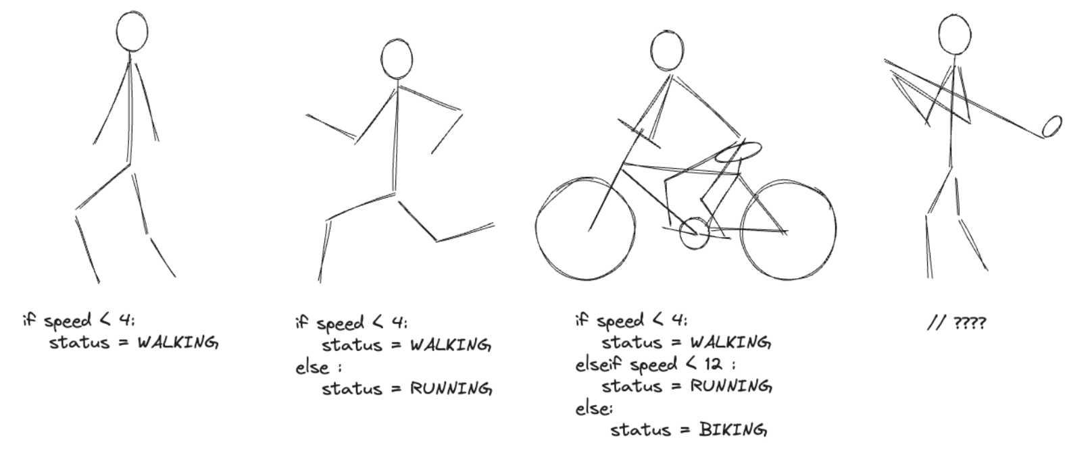
Traditional Programming (2)
Example: activity detection

Slide 5
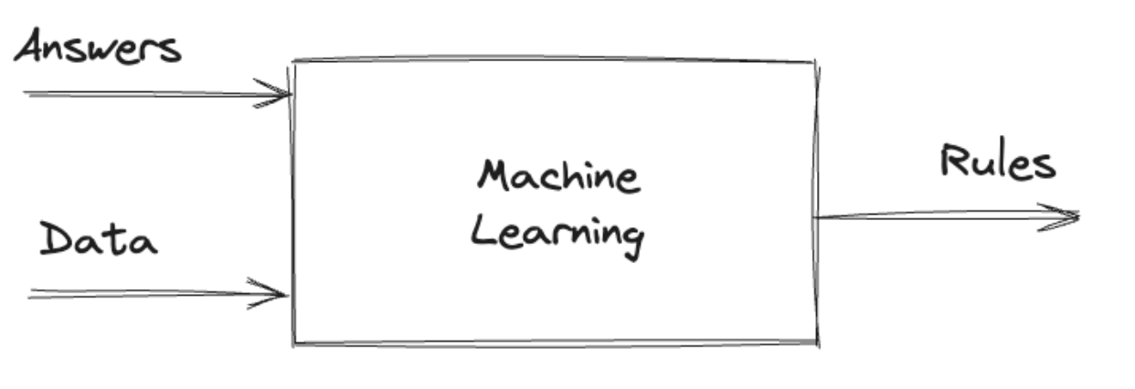
Machine Learning (1)
Programmer feeds data into an algorithm and lets it discover the rules
ML algorithm builds a model of the system based on the data provided, through a process we call training
We run data through the model to make predictions, in a process called inference
A technique for using computers to predict things based on past observations

Slide 6
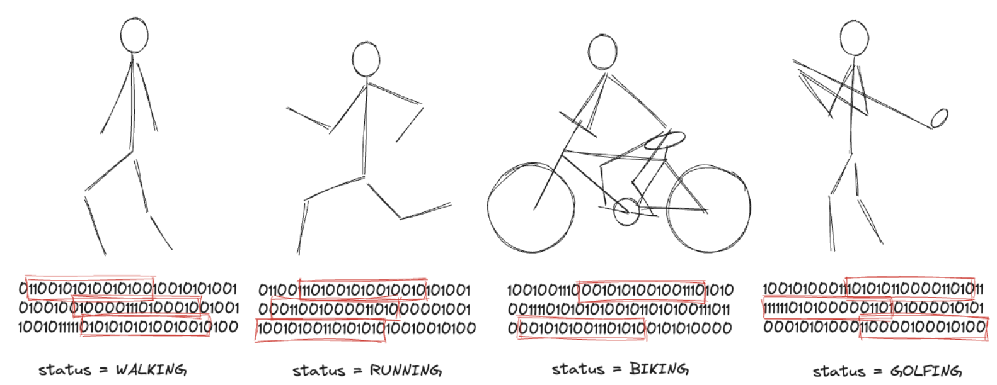
Machine Learning (2)
matching parts of the data with the label that describes the activity, the computer might be able to figure out the rules for what makes an activity walking or running or biking or even golfing!

Slide 7
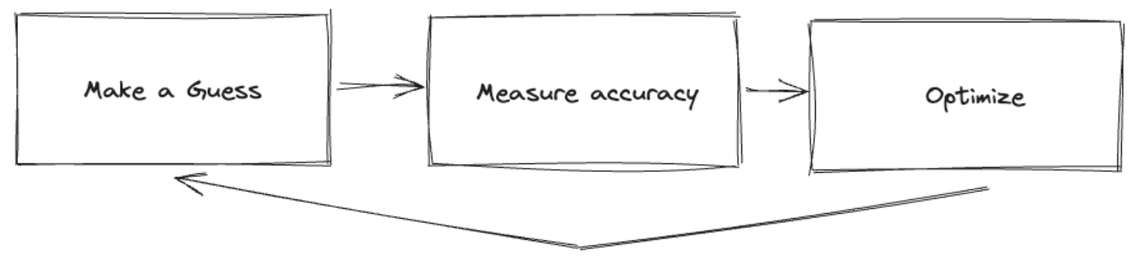
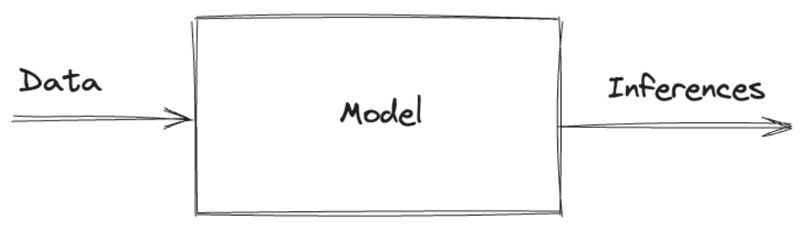
Machine Learning (3)
ML make a guess about to the relationship between the data and its labels
Then it measures how good or how bad that guess is (accuracy)
Then it use this measure to figure out a new better guess
If we repeat the process, each subsequent guess gets better than the previous one (learning from experience) and we constructs a model that can then used to label new data (inference)

Slide 8
Model definition
A mathematical relationship that exists between different variables
a business model takes inputs like “number of users” and “number of employees” to outputs annual profit
model based on simple mathematical relationships: profit is revenue minus expenses
a cookbook recipe is a model that relates inputs like “number of eaters” to quantities of ingredients needed
model based on trial and error, someone tried different combinations of ingredients
ML refers to creating and using models that are learned from data
the goal is to use existing data to build models that can be used to predict new data
A computer program is said to learn from experience (E) with respect to some task (T) and some performance measure (P), if its performance on T, as measured by P, improves with experience E [Tom Mitchell, Machine Learning, 1998]
Example: spam classification problem, the task is to predict emails as spam or not spam, the experience is the observed user labels as spam or not spam and the performance measure is the number of emails that are correctly predicted

Slide 9
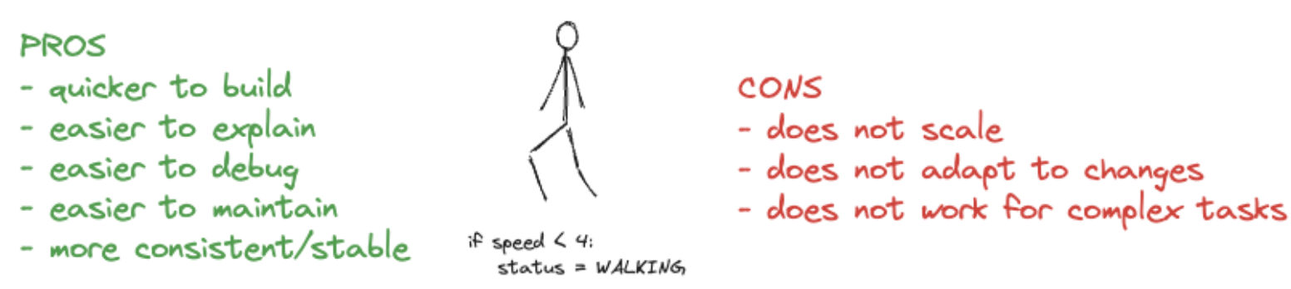
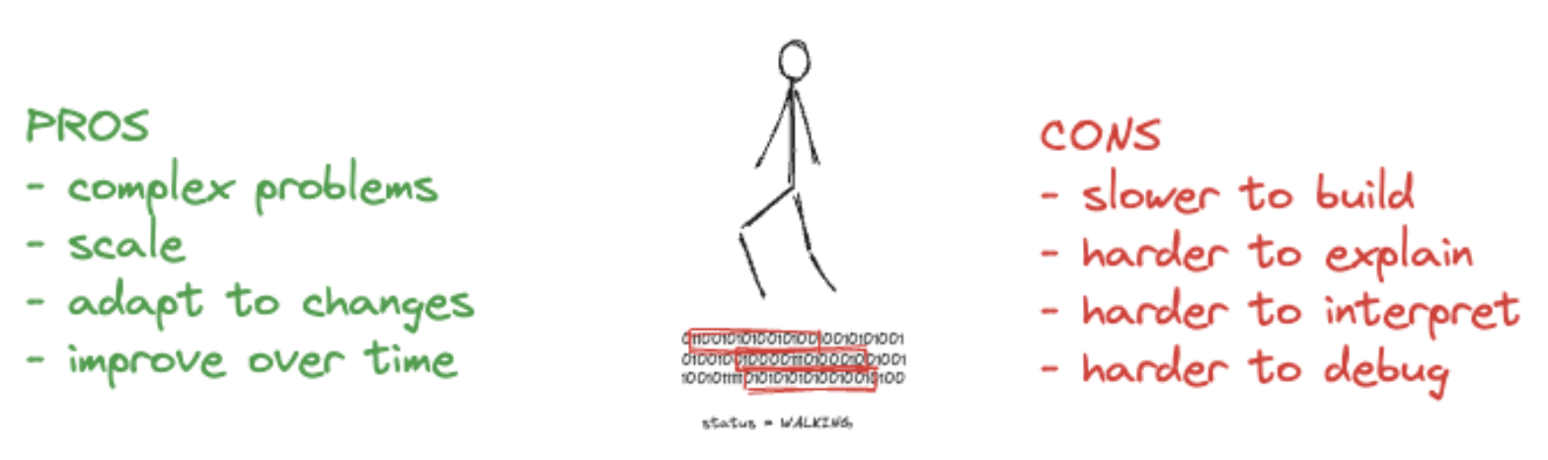
Comparison
Traditional programming:
Machine Learning:

Slide 10
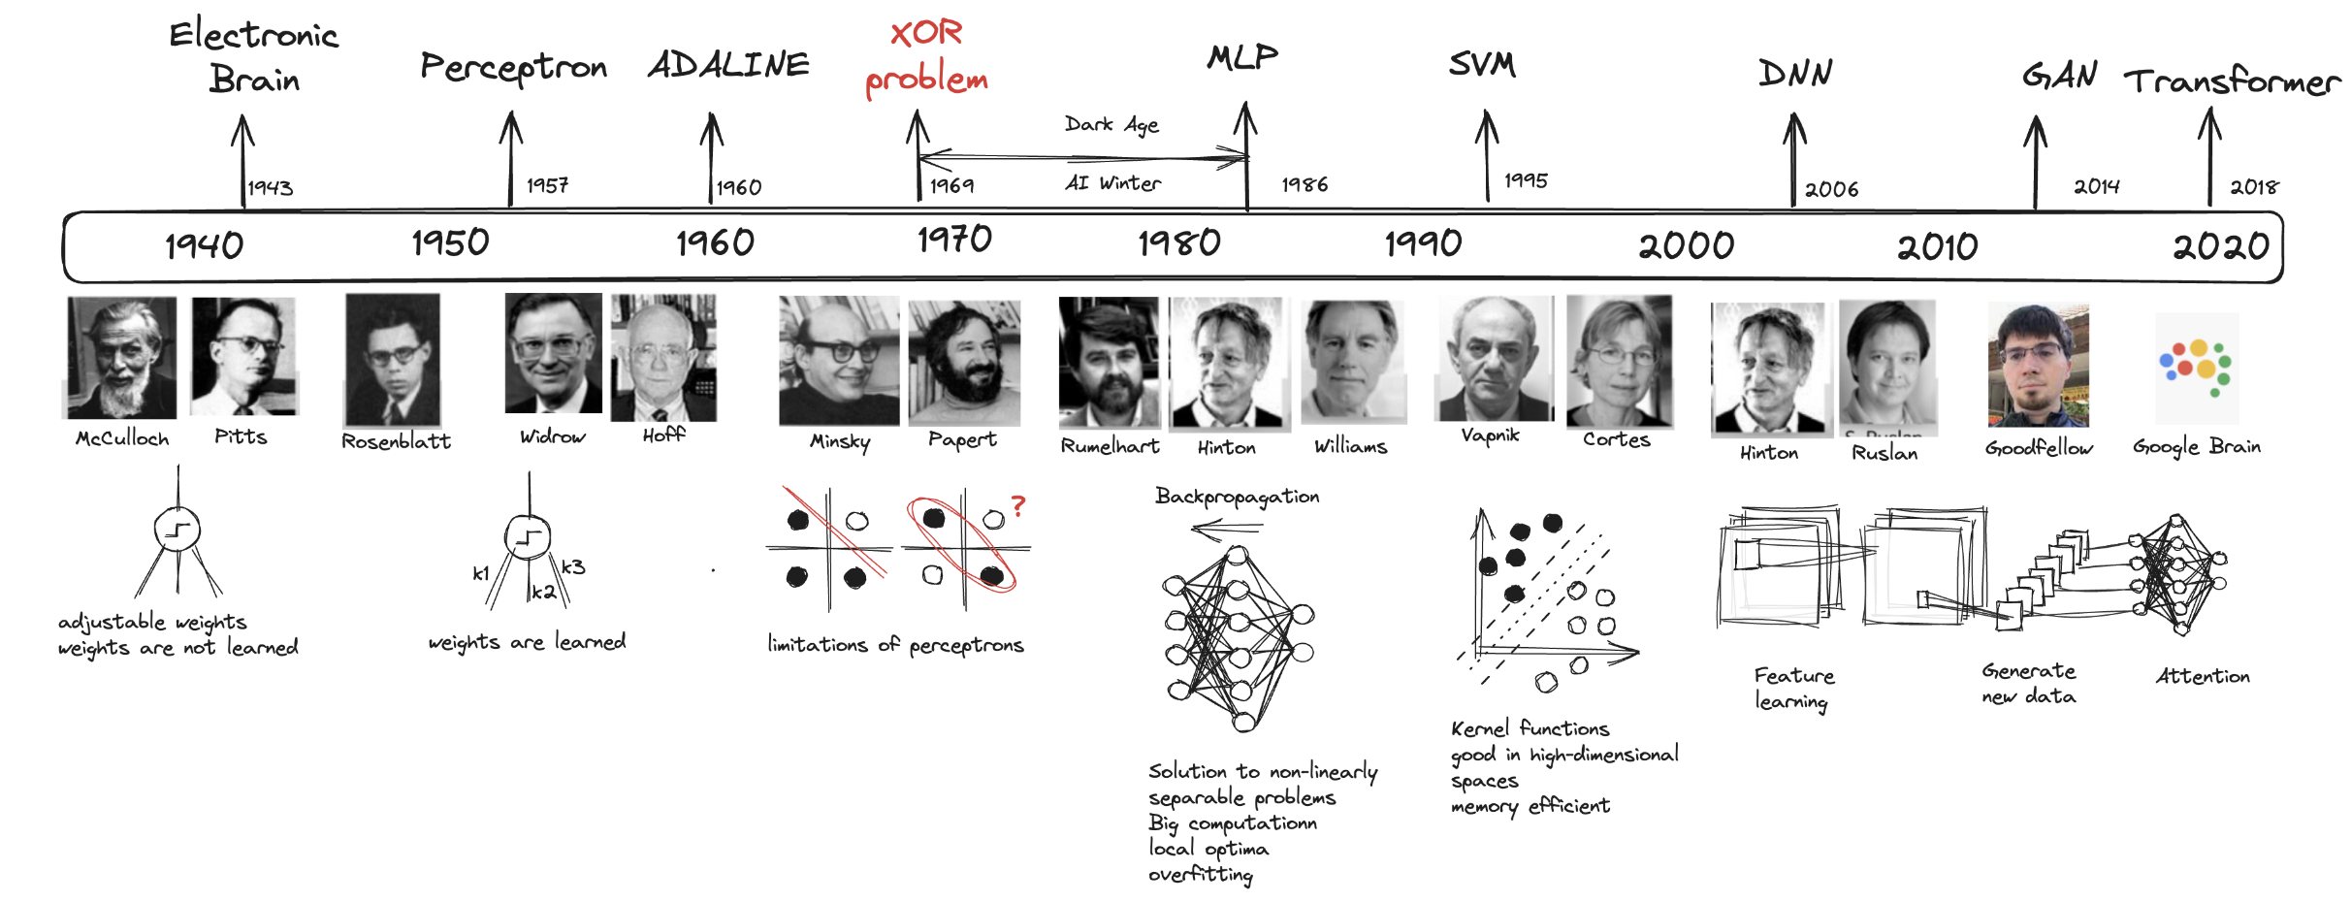
A brief History of Neural Networks
Core concepts were in place by the 80s
What happened from 2010 that changed things?

Slide 11
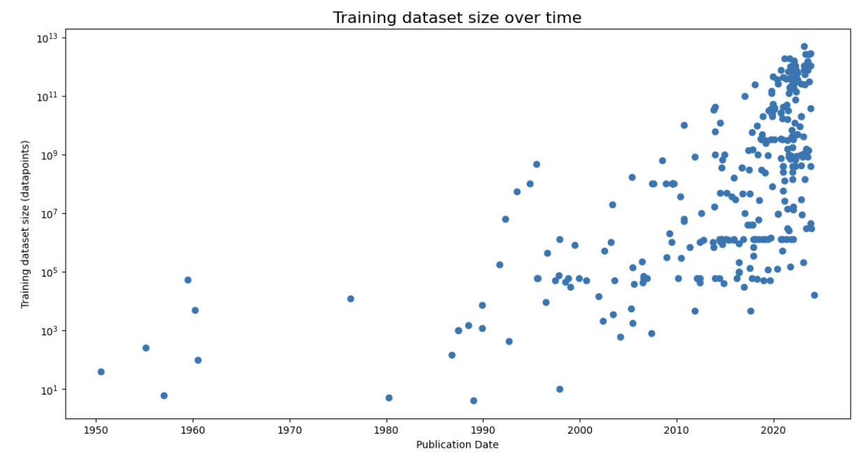
Large, high-quality labelled datasets

Slide 12
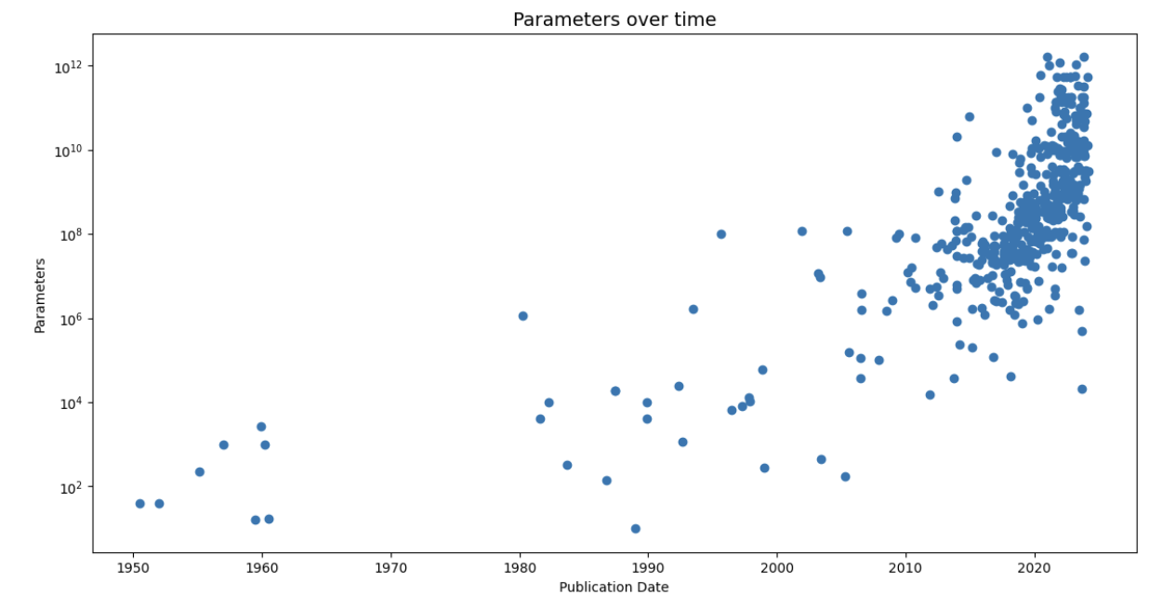
Models are getting bigger and bigger

Slide 13
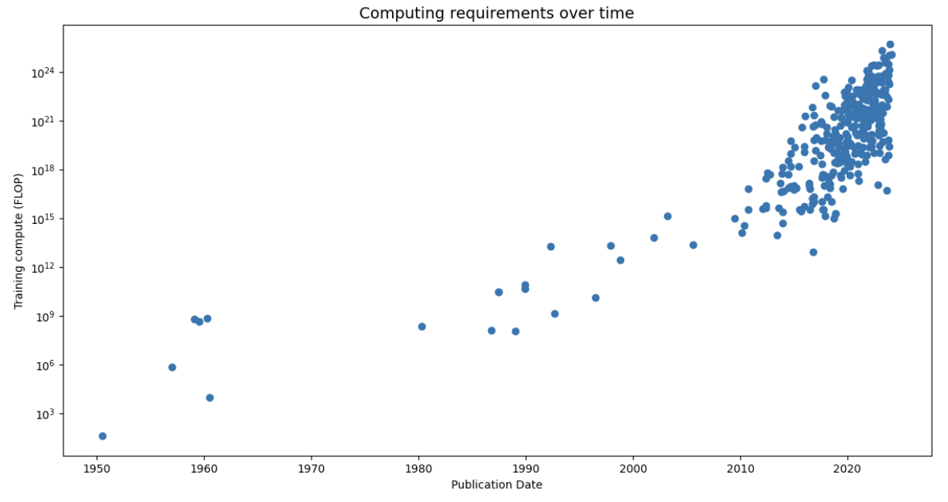
Computing requirements are growing

Slide 14
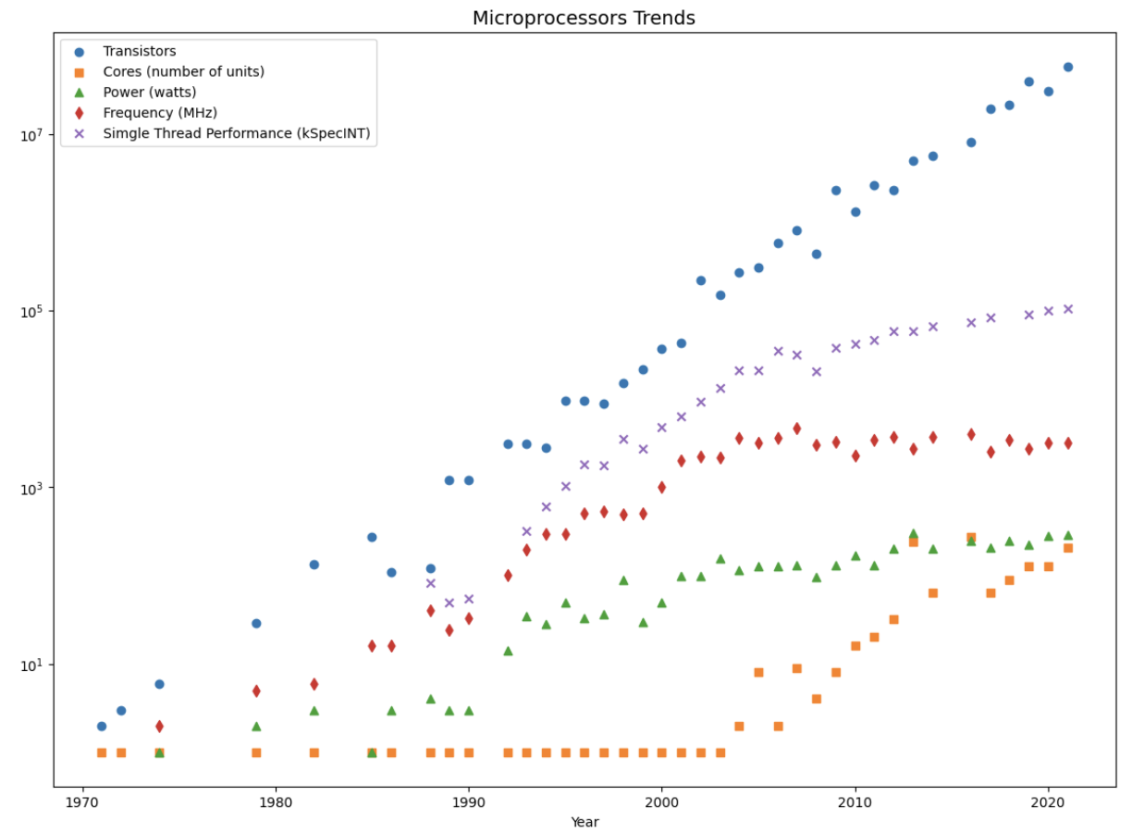
Parallelism help us!

Slide 15
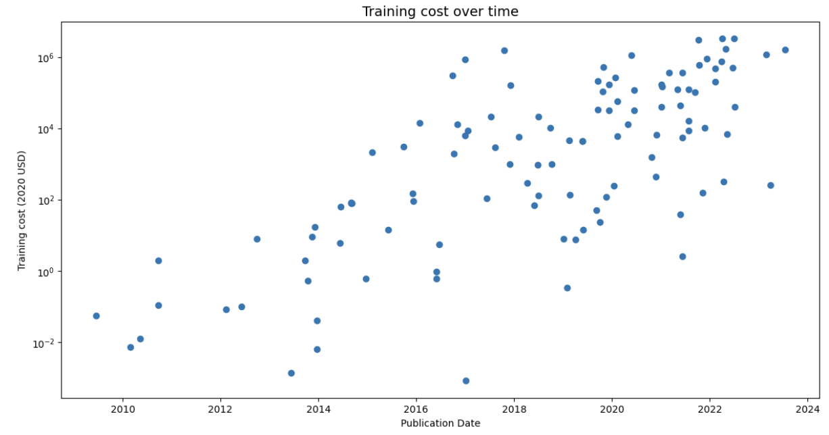
However, costs are out of control

Slide 16
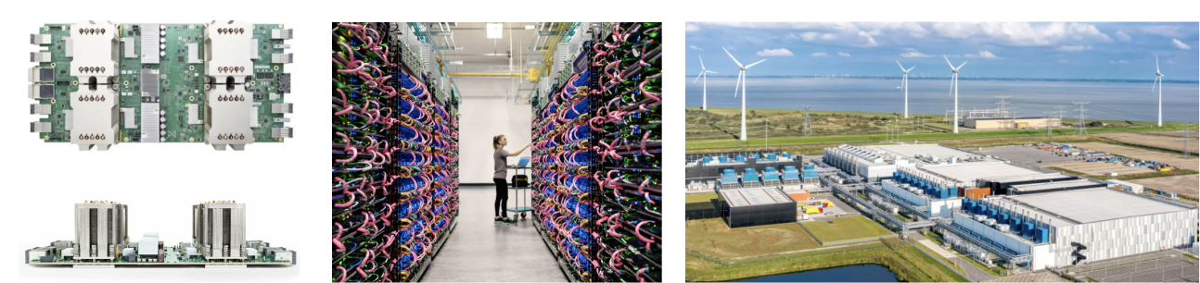
Big models
Those costs can be afforded only by large organizations
companies like Google have been building custom processors
packing them into big racks
all of these things are being sandwiched into big data centers
that consume so much power that they must be physically put right next to power sources and waters
A significant barrier to entry for smaller teams
Growing need for more efficient algorithms and techniques

Slide 17
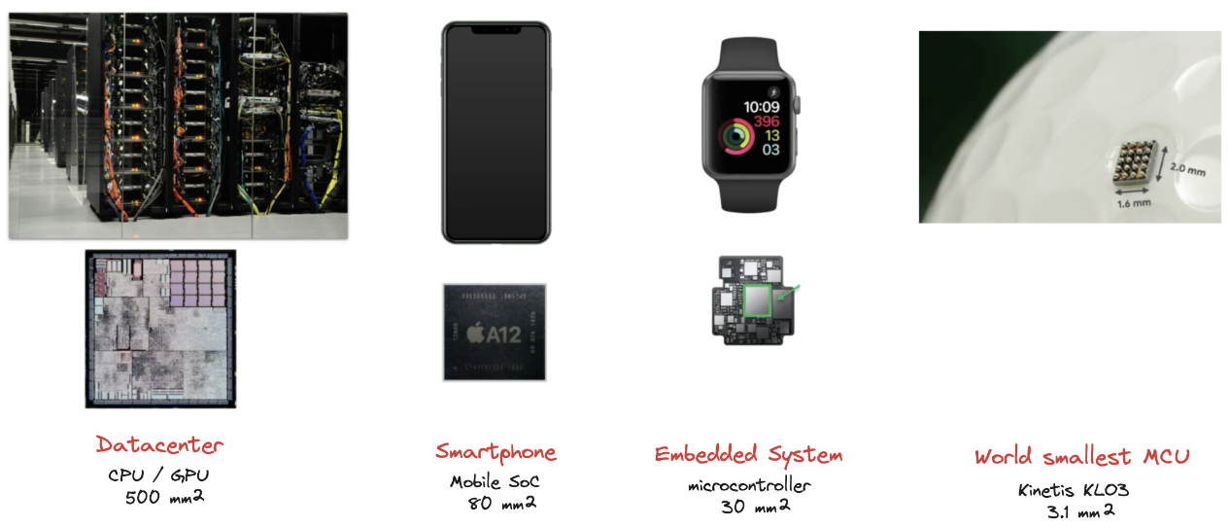
Go tiny! (1)
Another interesting trend: growing of embedded systems equipped with small microcontrollers
Some devices can run for days, weeks, months, sometimes even years with a coin cell battery, or also without any battery and harvesting energy from the surroundings

Slide 18
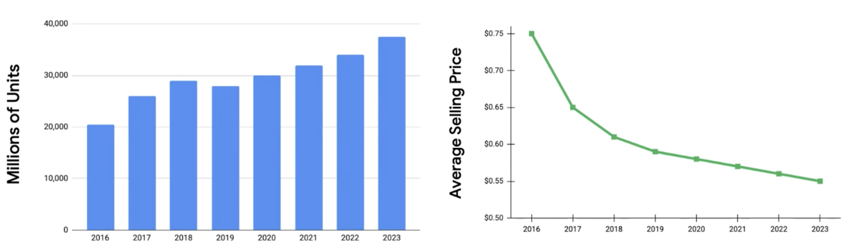
Go tiny! (2)
The demand for microcontrollers in the world is growing
we are building so many new devices
price is dropping because they are so pervasive
Cheap enough to include in almost any object (cars, coffeemaker, fridge, everywhere)
Summarizing: devices really small (can be completely pervasive), consume very little power (can be deployed for long times on small batteries), and really cheap (can be everywhere)

Slide 19
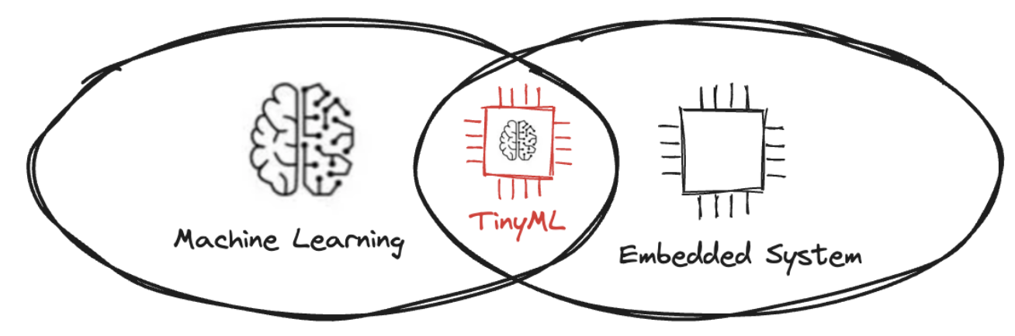
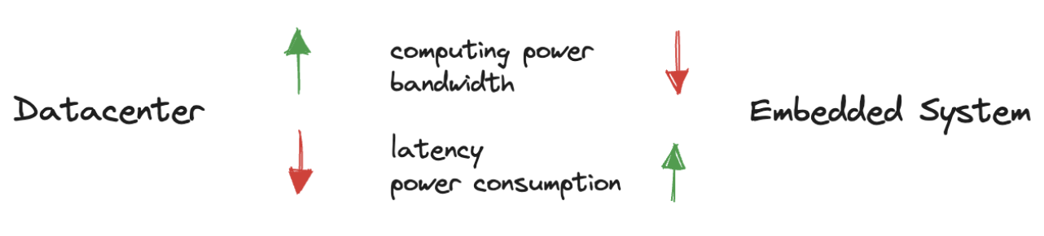
Go tiny! (3)
Idea! Tiny machine learning (TinyML): bring machine learning models to the embedded system!
We want to move from data centers to embedded devices
process data locally and quickly, rather than getting the data, sending it off somewhere in the cloud, and then bringing results back
saving power and time

Slide 20
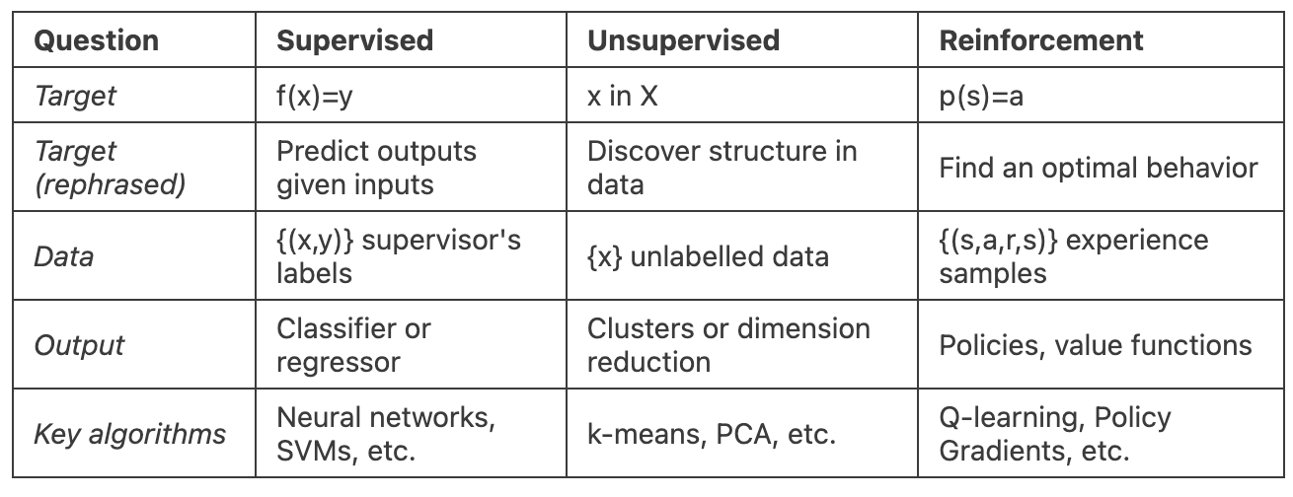
Supervised, Unsupervised, Reinforcement Learning
Supervised ML
there is a set of data labelled with the correct answers to learn from
Unsupervised ML
there are no such labels
Reinforcement Learning
after making a series of predictions, the model gets a signal indicating how well it did

Slide 21
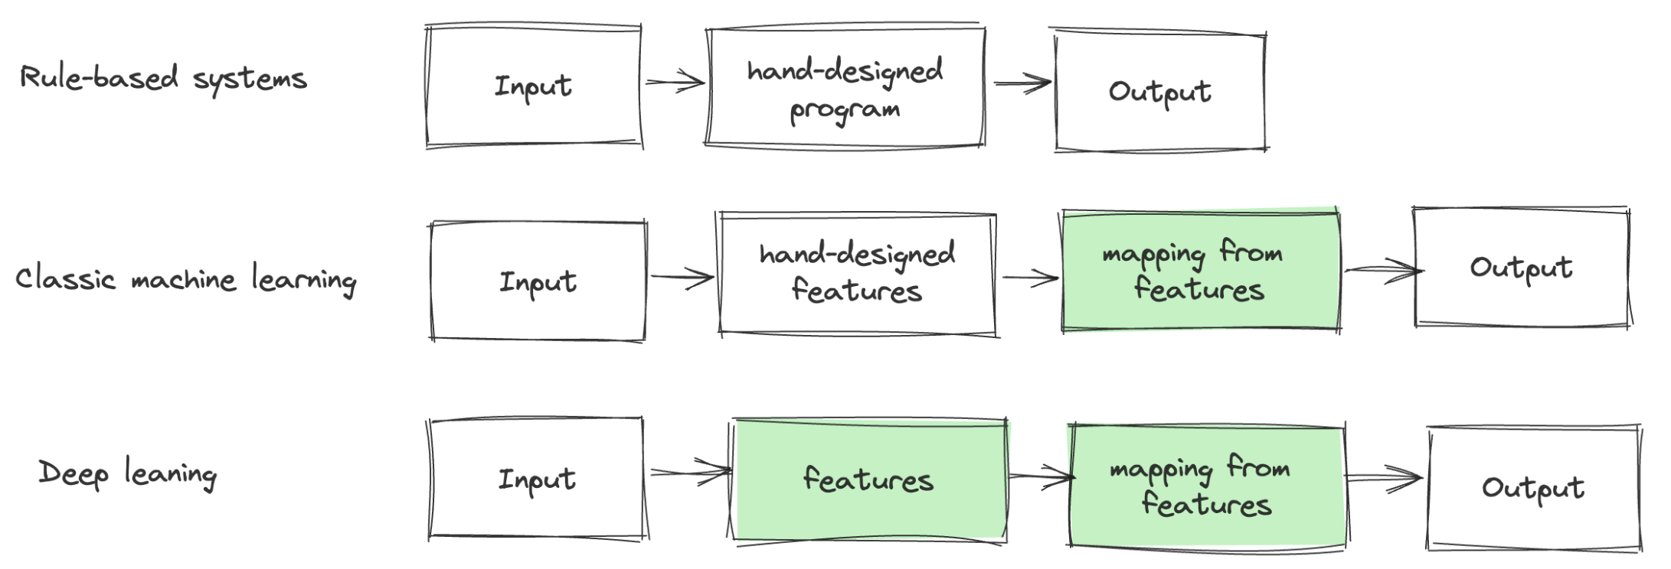
Deep Learning
Many factors influence every single piece of data
individual pixels in an image of a red object might be very close to black at night
shape of object silhouette depends on the viewing angle
Applications require us to discard factors that we do not care about
very difficult to extract such high-level, abstract features from raw data
can be identified using human-level understanding (e.g. speaker’s accent)
Deep learning solves this problem

Slide 22

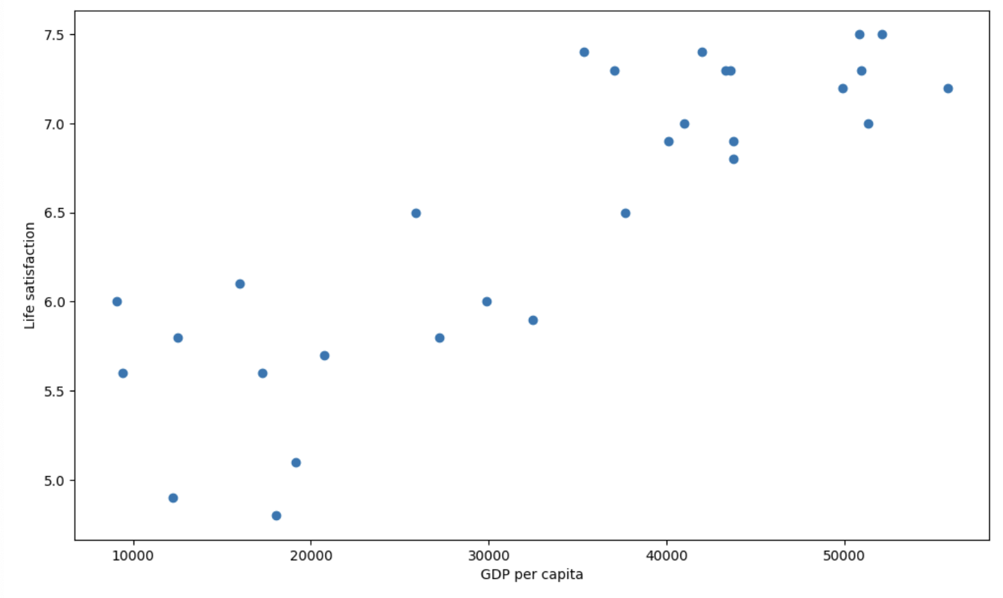
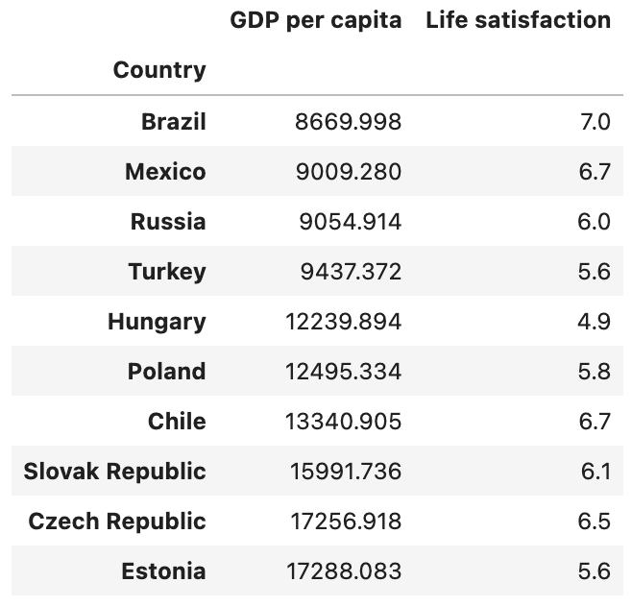
Example: does money make people happy? (1)
“Better Life Index” (bli)
“Gross Domestic Product” (gdp) datasets
It seems to be a trend!
Generalize: how to predict values for new instances
instance-based learning vs model-based learning

Slide 23
Example: does money make people happy? (2)
We can decide to model it as a linear function of GDP per capita (model-based learning)
model selection
Before we can use the model (inference), we need to define its parameters (training)
how can we know which values will make the model perform best?
We need to specify a performance measure
we can either define a utility function that measures how good the model is
or we can define a cost function that measures how bad it is
for linear models, we use a cost function to measures the distance between the model predictions and the dataset examples
Linear Regression algorithm
finds the parameters that make the model fit best the examples

Slide 24
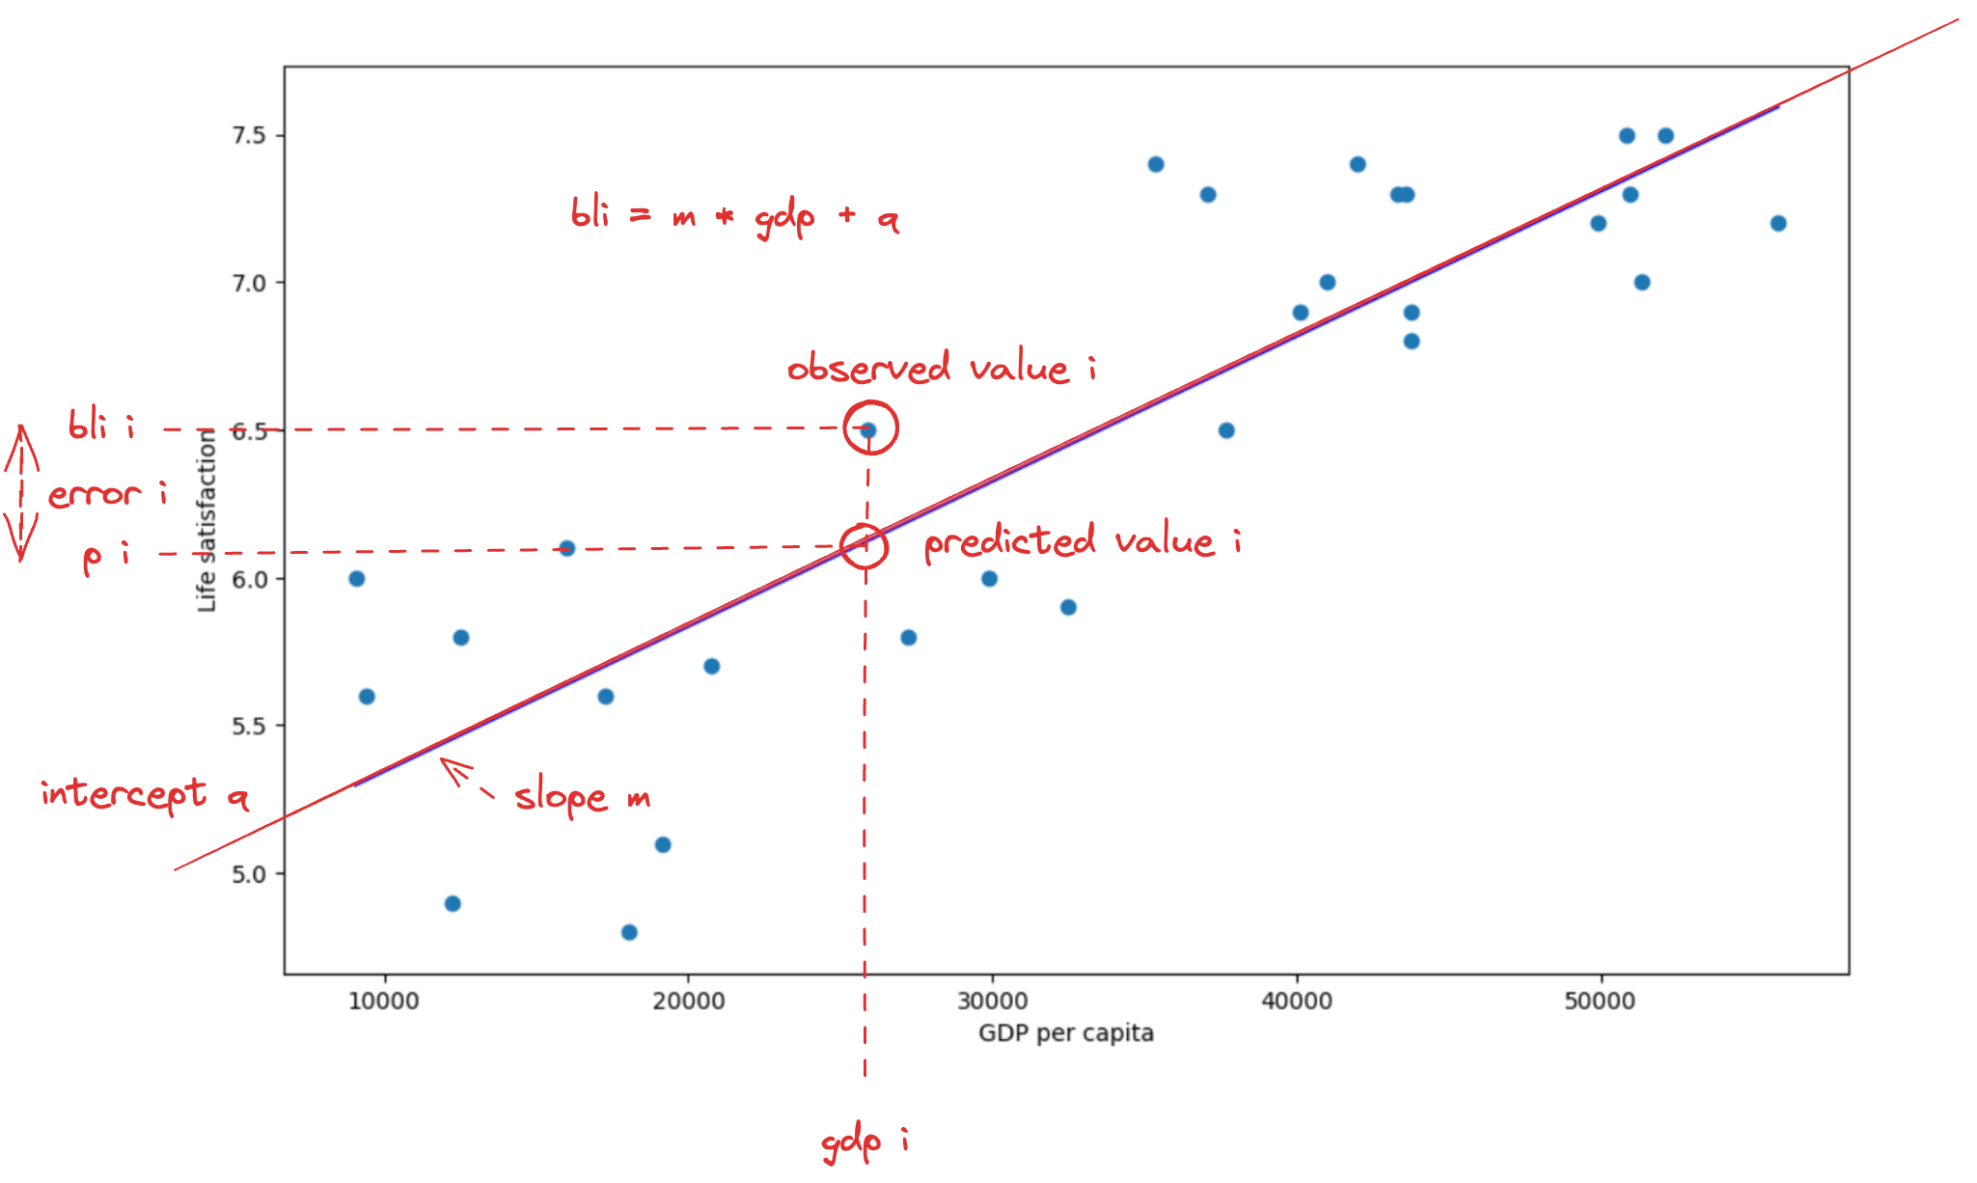
Example: does money make people happy? (3)

Slide 25
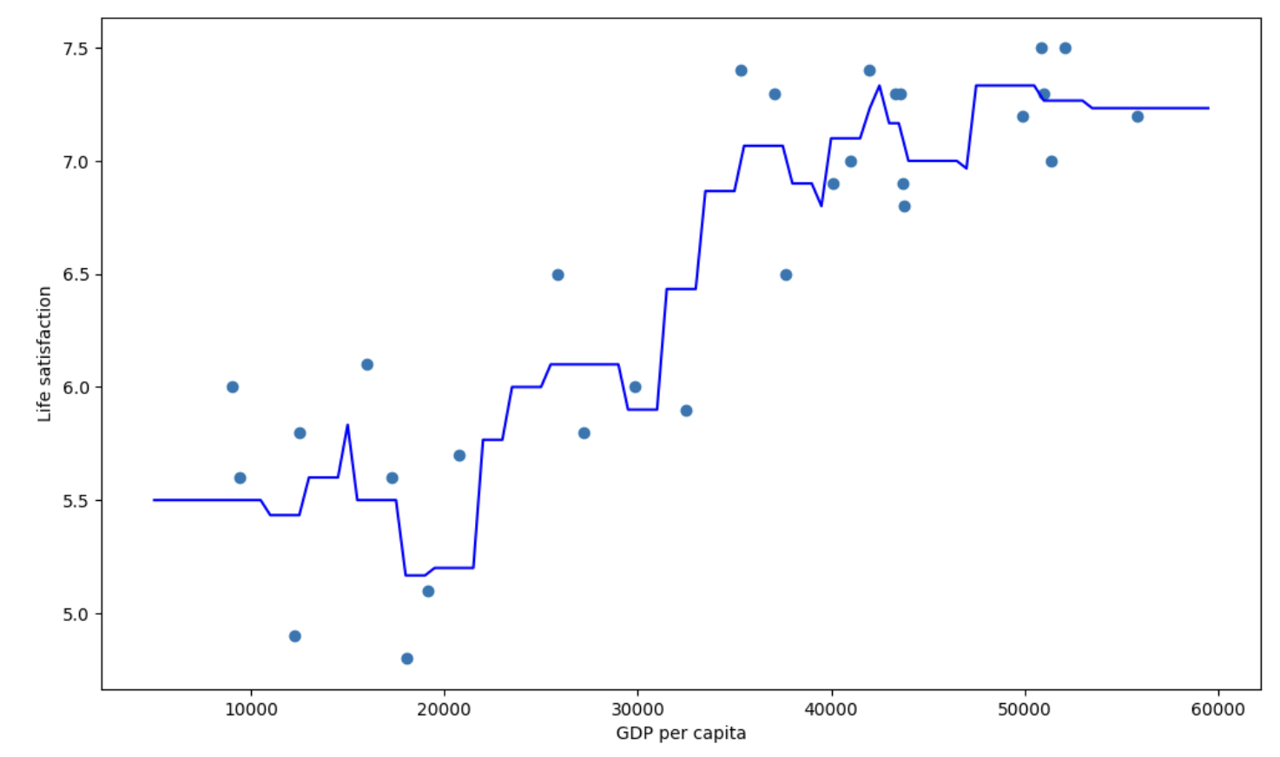
Example: does money make people happy? (4)
We can apply an instance-based algorithm instead
Nearest Neighbors (KNN) regression
we search around each gdp value and look at the closest countries
then we average these values

Slide 26
Example: does money make people happy? (5)
We can run the model to make predictions on unknown data (inference).
how happy Cypriots are?
the OECD data does not have the answer!
we can use our model to make a prediction: Cyprus gdp per capita is $22,587
Linear model prediction: 5.96
KNN prediction: 6.76
If all went well, our model would make good predictions
If not, we may need to use more attributes (employment rate, health, air pollution, etc.), get more or better-quality datasets, or perhaps select a more powerful model (e.g., a polynomial regression model)

Slide 27
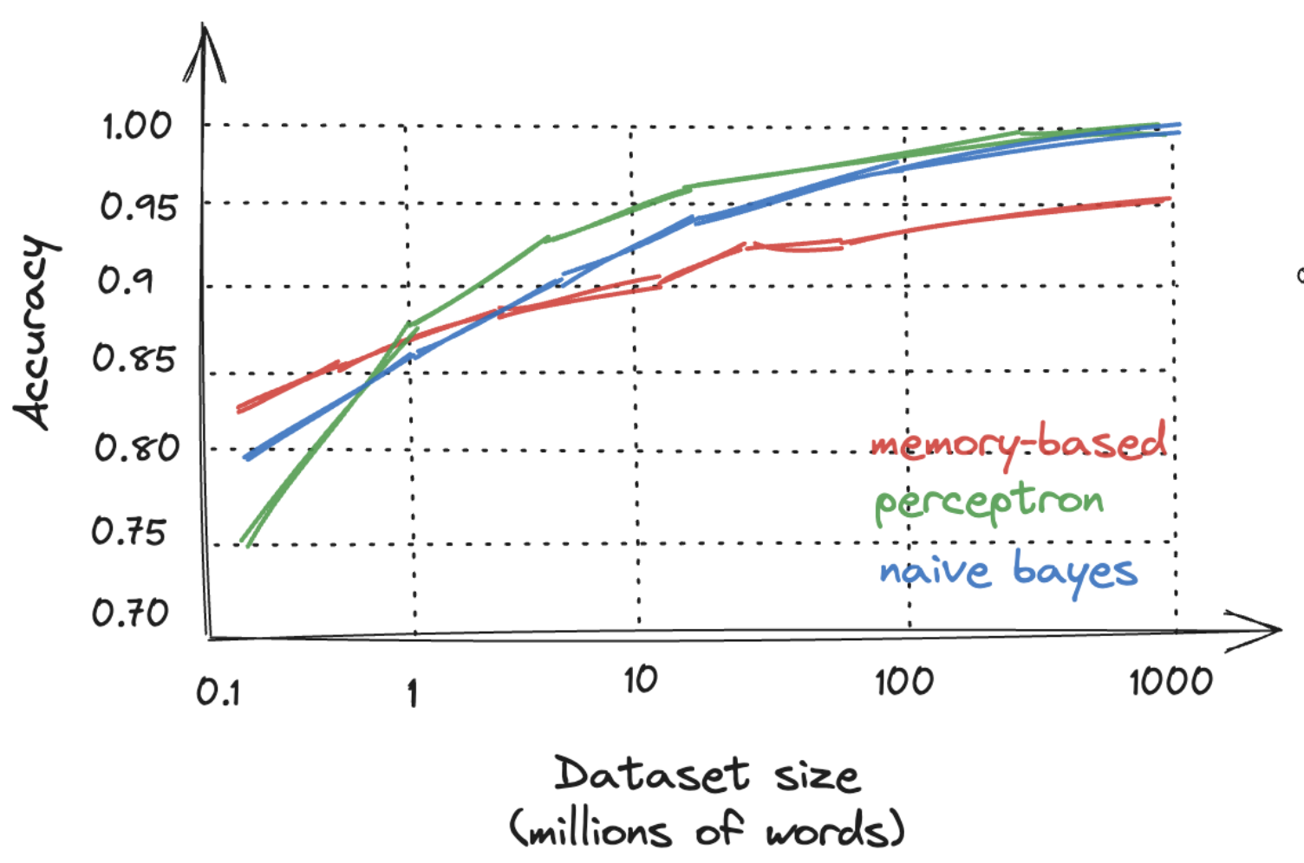
Challenges: Insufficient Quantity of Data
We teach a child what an apple is, just pointing to an apple and saying "apple”, then the child can recognize apples in all sorts of colours and shapes
ML is not quite there yet!
even for very simple problems, we typically need thousands of examples
and for complex problems (image or speech recognition) we may need millions of examples
An interesting result is that very different algorithms perform identically well on complex problems once they were given enough data!
[M. Banko, E. Brill. "Scaling to Very Very Large Corpora for Natural Language Disambiguation”]
We need to consider the trade-off between spending time and money on algorithm development versus corpus development

Slide 28
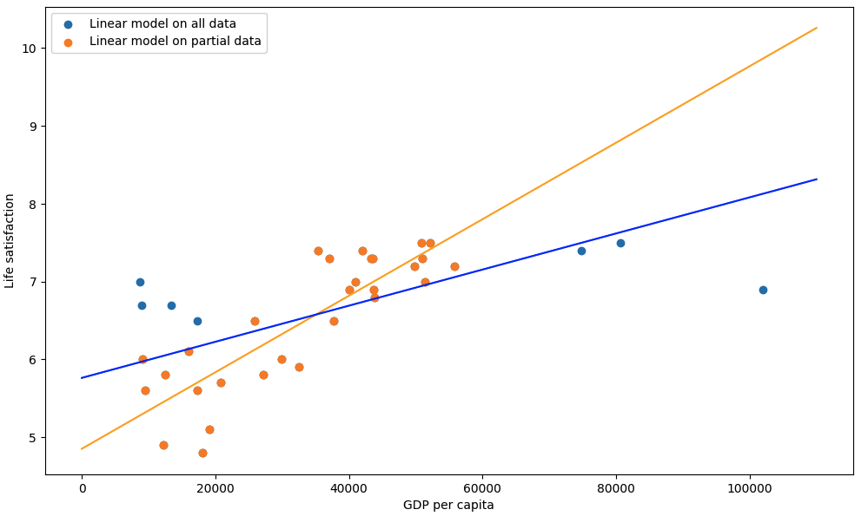
Challenges: Nonrepresentative Dataset (1)
The dataset should be representative of the new cases we want to generalize to
set of countries we used earlier was not perfect: a few countries were missing
adding missing countries significantly alter the model

Slide 29
Challenges: Nonrepresentative Dataset (2)
It makes clear that the simple linear model is probably never going to work well
very rich countries are not happier than moderately rich countries
some poor countries seem happier than many rich countries
Using a nonrepresentative dataset, we trained a model that is unlikely to make accurate predictions
This is often harder to have a representative dataset:
if the sample is too small, we will have sampling noise
i.e., nonrepresentative data as a result of chance
but even very large samples can be nonrepresentative if the sampling method is flawed: sampling bias

Slide 30
Challenges: Poor-Quality Data
Obviously, if the dataset is full of errors, outliers, and noise, it will make it harder for the system to detect the underlying patterns
e.g., due to poor-quality measurements
the model is less likely to perform well
It is often well worth the effort to spend time cleaning up dataset
As the saying goes: garbage in, garbage out
our system will only be capable of learning if the dataset contains enough relevant features and not too many irrelevant ones

Slide 31
Challenges: Overfitting (1)
We are visiting a foreign country, and the taxi driver rips we off
we might be tempted to say that “all taxi drivers in that country are thieves”
overgeneralizing is something that we humans do all too often
Unfortunately, machines can fall into the same trap: overfitting
the model performs well on the dataset, but it does not generalize well
For example, we can use a high-degree polynomial model

Slide 32
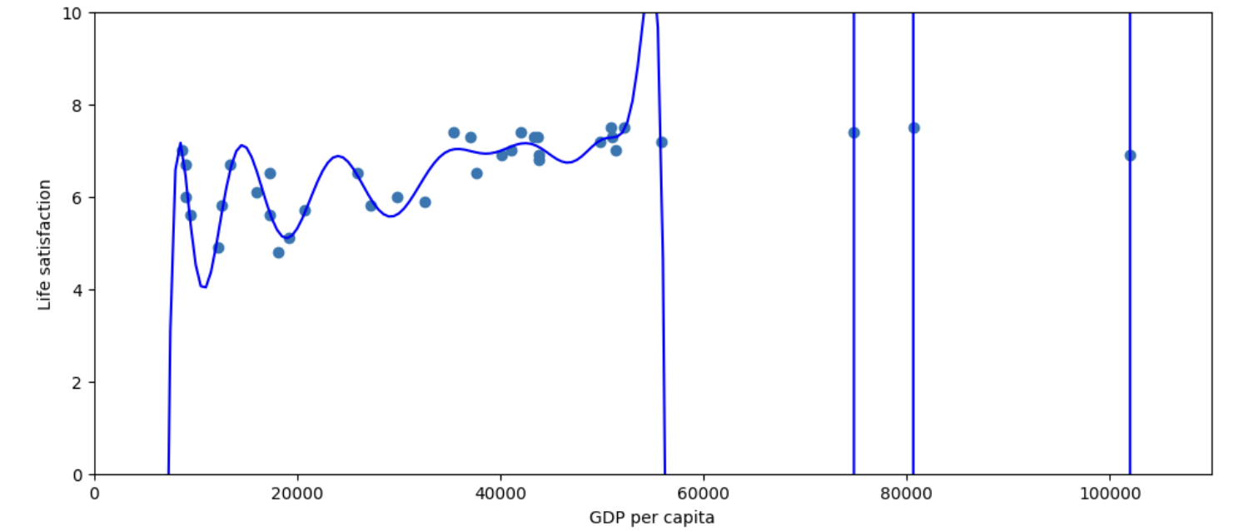
Challenges: Overfitting (2)
It strongly overfits: perfect on the training set, but we trust its predictions?
Complex models can detect patterns in the noise
simplify the model by selecting one with fewer parameters
constraining the model (regularization)
gather more data and/or reduce the noise in the dataset
For example, we can regularize our linear model

Slide 33
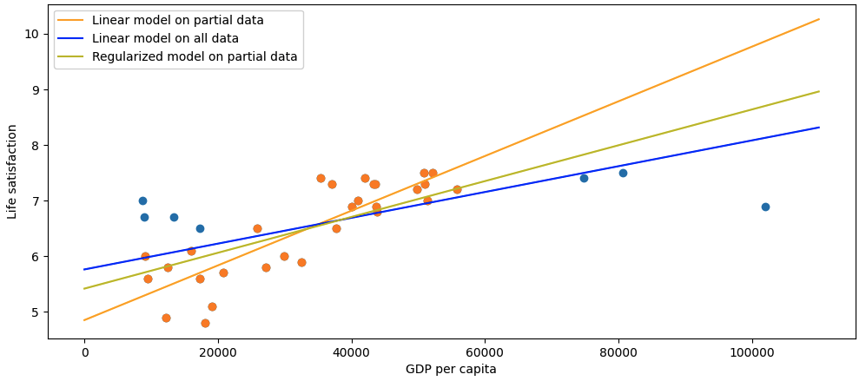
Challenges: Overfitting (3)
It has two degrees of freedom (height and slope)
we can force the slope=0 to have only one degree of freedom
the model does not fit the dataset as well as the first model, but it generalizes better
Amount of regularization to apply can be controlled by a hyperparameter
a parameter of a learning algorithm, not of the model
We need to find the right balance between fitting the dataset perfectly and keeping the model simple enough to ensure that it will generalize well

Slide 34
Challenges: Underfitting
It occurs when the model is too simple to learn the underlying structure of the data
For example, the linear model is prone to underfit
reality is just more complex than the model
its predictions are bound to be inaccurate, even on the examples
The main options for fixing this problem:
select a more powerful model, with more parameters
feed better features to the learning algorithm (feature engineering)
reduce the constraints on the model
reduce the regularization hyperparameter

Slide 35
Testing
To know how well a model will generalize to new cases we can try it out on new cases
put the model in production and monitor how well it performs
if the model is horribly bad, the users will complain, not the best idea
Split data into two sets
the training set
the test set
train the model using the training set, and test it using the test set
The error rate on new cases is called the generalization error
how well the model will perform on instances it has never seen before
evaluating the model on the test set provides an estimate of this error
It is common to use 80% of the data for training and hold out 20% for testing

Slide 36
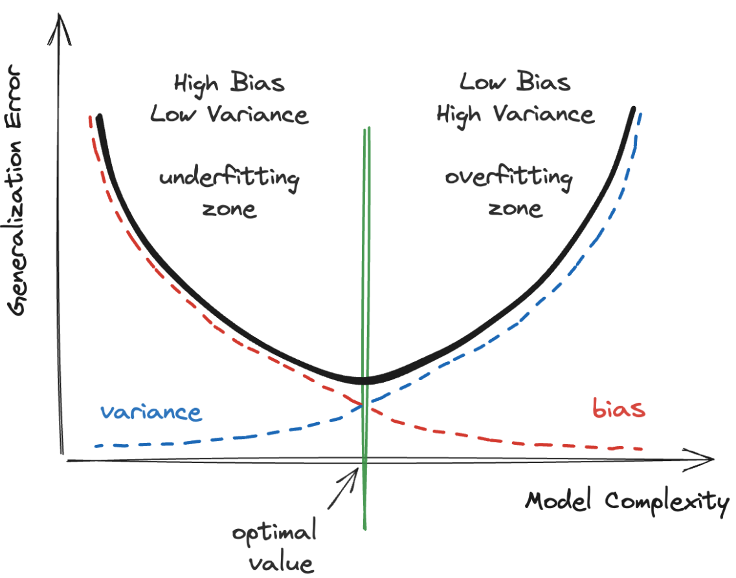
Bias and Variance

Slide 37
Validation
How do we choose the value of the regularization hyperparameter?
train several different models using different values for the hyperparameter
then select the value that produces the lowest generalization error
the model is unlikely to perform as well on new data!
If we measure the generalization error multiple times on the test set, we are adapting the model and hyperparameters to produce the best model for that particular set!
Hold out part of the training set to evaluate models: validation set
train multiple models with various hyperparameters on the reduced training set
then select the model that performs best on the validation set
train the best model on the full training set
evaluate the final model on the test set to get an estimate of the generalization error

Slide 38
No free-lunch theorem
A model is a simplified version of the observations, it discards the superfluous details that are unlikely to generalize to new instances
a linear model assumes that the data is fundamentally linear
distance between instances and the straight line is just noise: can safely be ignored
To decide what data to discard and what data to keep, we must make assumptions
If we make absolutely no assumption, there is no reason to prefer a model over any other
for some datasets the best model is a linear model
while for other datasets it is a neural network
There is no model that is a priori guaranteed to work better
the only way to know for sure the best model is to evaluate them all
since this is not possible, in practice we always make some reasonable assumptions about the data and evaluate only a few reasonable models
[D. H. Wolpert. "The Lack of A Priori Distinctions Between Learning Algorithms”]

